Slide 1
Graphics Output Primitives
Bresenhams Line Drawing Algortihm

Slide 2
Bresenham’s Line Algorithm
It is an efficient raster line generation algorithm.
It can be adapted to display circles and other curves.
The algorithm
  After plotting a pixel position (x_{k}, y_{k}) , what is the next pixel to plot?
Consider lines with positive slope.

Slide 3
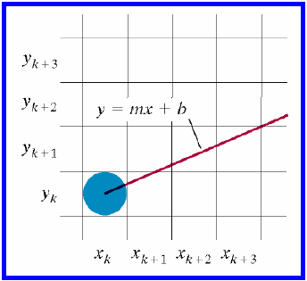
Bresenham’s Line
For a positive slope, 0 < m < 1 and line is starting from left to right.
After plotting a pixel position (x_{k}, y_{k}) we have two choices for next pixel:
  (x_{k} +1, y_{k})
  (x_{k} +1, y_{k}+1)

Slide 4
Bresenham’s Line
At position x_{k} +1, we pay attention to the intersection of the vertical pixel and the mathematical line path.

Slide 5
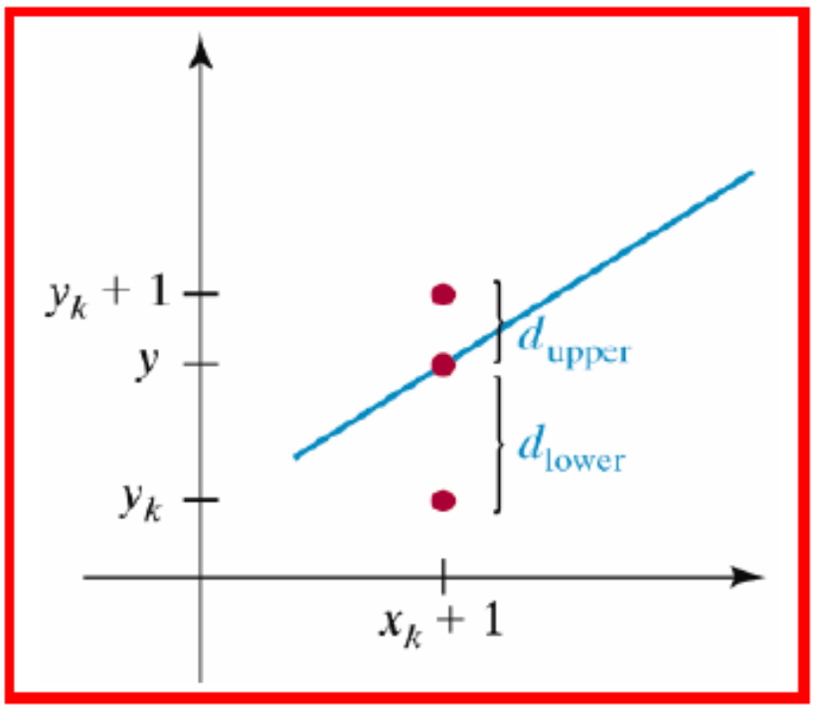
Bresenham’s Line
At position x_{k} +1, we label vertical pixel separations from the mathematical line path as
    d_{lower} , d_{upper}.

Slide 6
Bresenham’s Line
The y coordinate on the mathematical line at x_{k}+1 is calculated as
    y = m(x_{k} +1)+ b
then
    d_{lower} = y − y_{k}
        = m (x_{k} +1) + b − y_{k}
and
    d_{upper} =(y_{k} +1) − y
        = y_{k} +1− m(x_{k} +1)− b

Slide 7
Bresenham’s Line
To determine which of the two pixels is closest to the line path, we set an efficient test based on the difference between the two pixel separations
  d_{lower} - d_{upper} = 2m (x_{k} +1) − 2y_{k} + 2b - 1
        = 2 (Δy / Δx) (x_{k} +1) − 2y_{k} + 2b - 1
Consider a decision parameter p_{k} such that
      p_{k} = Δx (d_{lower} - d_{upper} )
        = 2Δy.x_{k} − 2Δx.y_{k} + c
where
      c = 2Δy + Δx(2b −1)

Slide 8
Bresenham’s Line
Since Δx > 0, Comparing (d_{lower} and d_{upper} ), would tell which pixel is closer to the line path; is it y_{k} or y_{k} + 1
If (d_{lower} < d_{upper} )
  Then p_{k} is negative
    Hence plot lower pixel.
  Otherwise
    Plot the upper pixel.

Slide 9
Bresenham’s Line
We can obtain the values of successive decision parameter as follows:
      p_{k} = 2Δy.x_{k} − 2Δx.y_{k} + c
      c = 2 Δy + Δx (2b-1) (constant)
      p_{k+1}=2Δy.x_{k+1}−2Δx.y_{k+1}+c
Subtracting these two equations
p_{k+1}− p_{k} = 2Δy (x_{k+1} − x_{k}) − 2Δx ( y_{k+1} − y_{k})
But x_{k+1} − x_{k} = 1, Therefore
      p_{k+1 =} p_{k} +2Δy − 2Δx (y_{k+1} − y_{k})

Slide 10
Bresenham’s Line
( y_{k+1} − y_{k}) is either 0 or 1, depending on the sign of p_{k} (plotting lower or upper pixel).
The recursive calculation of p_{k} is performed at integer x position, starting at the left endpoint.
p₀ can be evaluated as:
        p₀ = 2Δy − Δx

Slide 11
Remember that
      p_{k} = 2Δy.x_{k} − 2Δx.y_{k} + c (i)
      and c = 2 Δy + Δx (2b-1)
Since (x₀,y₀) satisfies the line equation , we also have
y₀ = Δy/ Δx * x₀ + b (ii)
Combining the above 2 equations , we will have
p₀ = 2Δy – Δx
end

Slide 12
Bresenham’s Line-Drawing Algorithm for m < 1
Input the two line end points and store the left end point in (x₀ , y₀ ).
Load (x₀ , y₀ ) into the frame buffer; that is, plot the first point.
Calculate the constants Δx, Δy, 2Δy, and 2Δy − 2Δx, and obtain the starting value for the decision parameter as
      p₀ = 2Δy − Δx
At each x_{k} along the line, starting at k = 0 , perform the following test: If p_{k} < 0,the next point to plot is (x_{k +1}, y_{k} and
      p_{k+1}=p_{k}+2Δy
  Otherwise, the next point to plot is (x_{k} +1, y_{k} +1) and
      p_{k+1}=p_{k}+2Δy−2Δx
5. Repeat step 4, Δx−1 times.

Slide 13
Summary
The constants 2Δy and 2Δy − 2Δx are calculated once for each line to be scan converted.
Hence the arithmetic involves only integer addition and subtraction of these two constants.

Slide 14
Example
To illustrate the algorithm, we digitize the line with endpoints (20,10) and (30,18). This line has slope of 0.8, with
    Δx = 10
    Δy =8
The initial decision parameter has the value
    p₀ = 2Δy − Δx = 6
and the increments for calculating successive decision parameters are
    2 Δy = 16
    2 Δy - 2 Δx = -4

Slide 15
Example
We plot the initial point (x₀ , y₀)=(20,10) and determine successive pixel positions along the line path from the decision parameter as
K | p_{k} | (x_{k +1}, y_{k +1}) | K | p_{k} | (x_{k +1}, y_{k +1})
0 | 6 | (21,11) | 5 | 6 | (26,15)
1 | 2 | (22,12) | 6 | 2 | (27,16)
2 | -2 | (23,12) | 7 | -2 | (28,16)
3 | 14 | (24,13) | 8 | 14 | (29,17)
4 | 10 | (25,14) | 9 | 10 | (30,18)

Slide 16
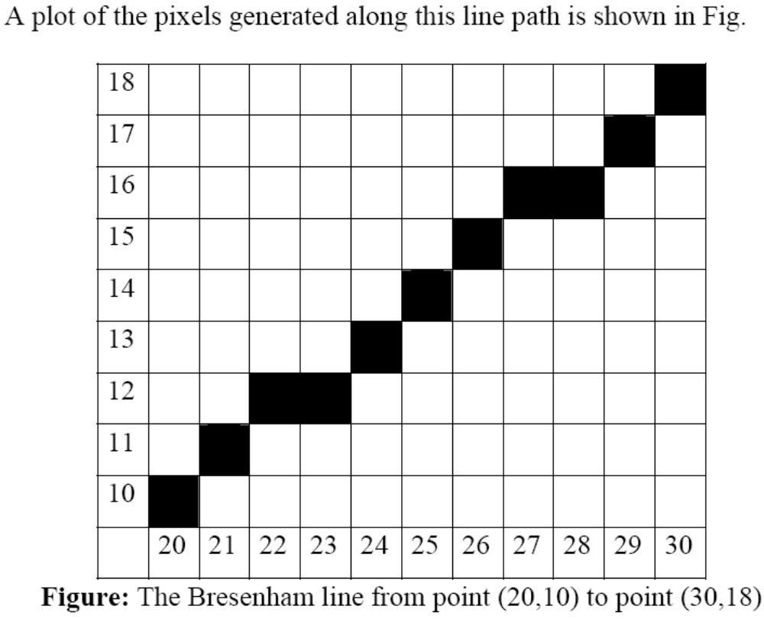
Example

